Slide 1
Do-while loops

Slide 2
Outline
In this lesson, we will:
Describe do-while loops
A variation of while loops
Look at two applications:
Required input from users or sensors
Fixed-point iteration
We will look at an engineering principle of static determination

Slide 3
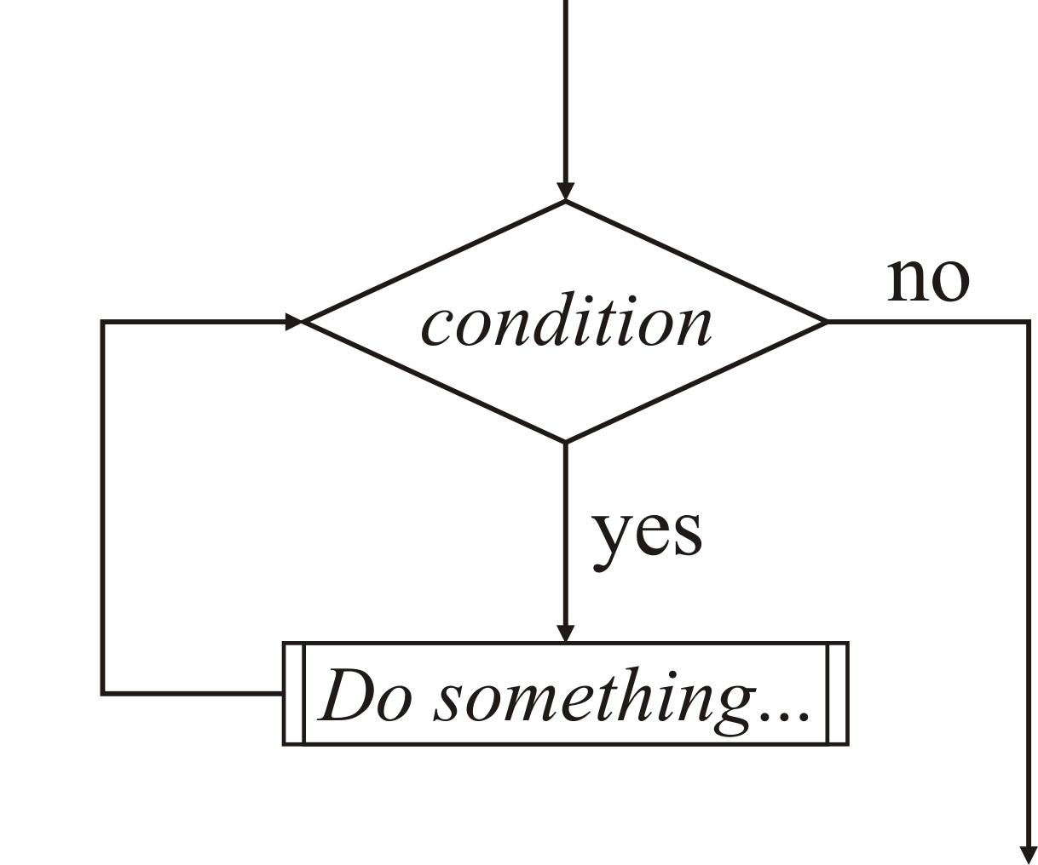
Looping statements
A while loop has the following flow chart
It requires that the condition is initially true

Slide 4
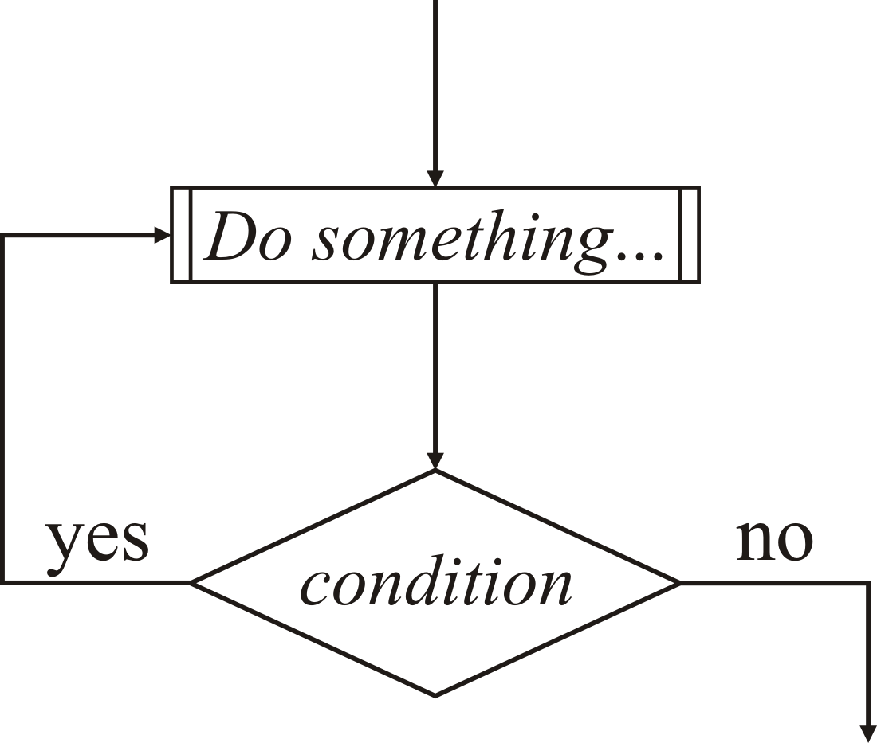
Looping statements
In some circumstances, it may not be possible to determine if any condition is true prior to any execution

Slide 5
Do-while loops
A do-while loop is essentially a while loop that does not check the condition before the first time the block of statements is executed
do {
The looped block of statements
- to be executed as long as the
condition is 'true'
} while ( Boolean-valued condition );
// Continue executing here as soon as the
// condition evaluates to 'false'
Note the semicolon

Slide 6
Example: user input
For example, suppose you absolutely require input from the user
This could be checked before, but leads to repeated code
void high_low_game() {
int target{(std::rand() % 100) + 1};
int guess{};
std::cout << "Pick a number between 1 and 100: ";
std::cin >> guess;
while ( guess != target ) {
if ( guess < target ) {
std::cout << "Low" << std::endl;
} else {
assert( guess > target );
std::cout << "High" << std::endl;
}
std::cout << "Pick a number between 1 and 100: ";
std::cin >> guess;
}
std::cout << "Good guess" << std::endl;
}

Slide 7
Example: user input
The repetition of the code can be avoided
void high_low_game() {
int target{(std::rand() % 100) + 1};
int guess{};
do {
std::cout << "Pick a number between 1 and 100: ";
std::cin >> guess;
if ( guess < target ) {
std::cout << "Low" << std::endl;
} else if ( guess > target ) {
std::cout << "High" << std::endl;
}
} while ( guess != target );
std::cout << "Good guess" << std::endl;
}

Slide 8
Example: user input
Try this yourself:
#include <iostream>
#include <cstdlib>
// Function declarations
void high_low_game();
int main();
// Function definitions
int main() {
high_low_game();
return 0;
}
void high_low_game() {
int target{(std::rand() % 100) + 1};
int guess{};
do {
std::cout << "Pick a number between 1 and 100: ";
std::cin >> guess;
if ( guess < target ) {
std::cout << "Low" << std::endl;
} else if ( guess > target ) {
std::cout << "High" << std::endl;
}
} while ( guess != target );
std::cout << "Good guess" << std::endl;
}

Slide 9
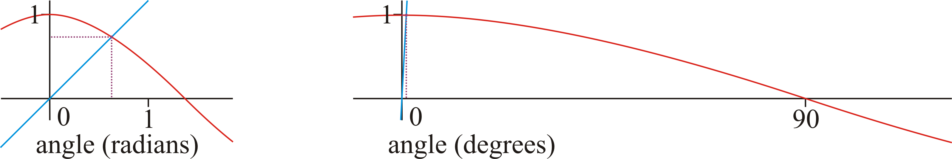
Fixed-point iteration
As a second example: significant scientific computation starts with an approximation and iterates to find a better solution
If successive iterations are sufficiently close, we assume that it is a good approximation
This requires at least one iteration to see if we are sufficiently close
For example, to find a point x such that x = cos(x), under some circumstances, all you must do is pick a starting point and repeatedly apply cos to an initial value

Slide 10
Fixed-point iteration
You can do this with your calculator:
You keep iterating until two consecutive solutions are close enough
Using radians:
1.0
0.5403023058681397
0.8575532158463934
0.6542897904977792
0.7934803587425656
0.7013687736227565
0.7639596829006542
0.7221024250267078
Using degrees:
1.0
0.9998476951563912
0.9998477415452118
0.9998477415310838
0.9998477415310881
0.9998477415310881
Ultimately, it converges to:
0.7390851332151606

Slide 11
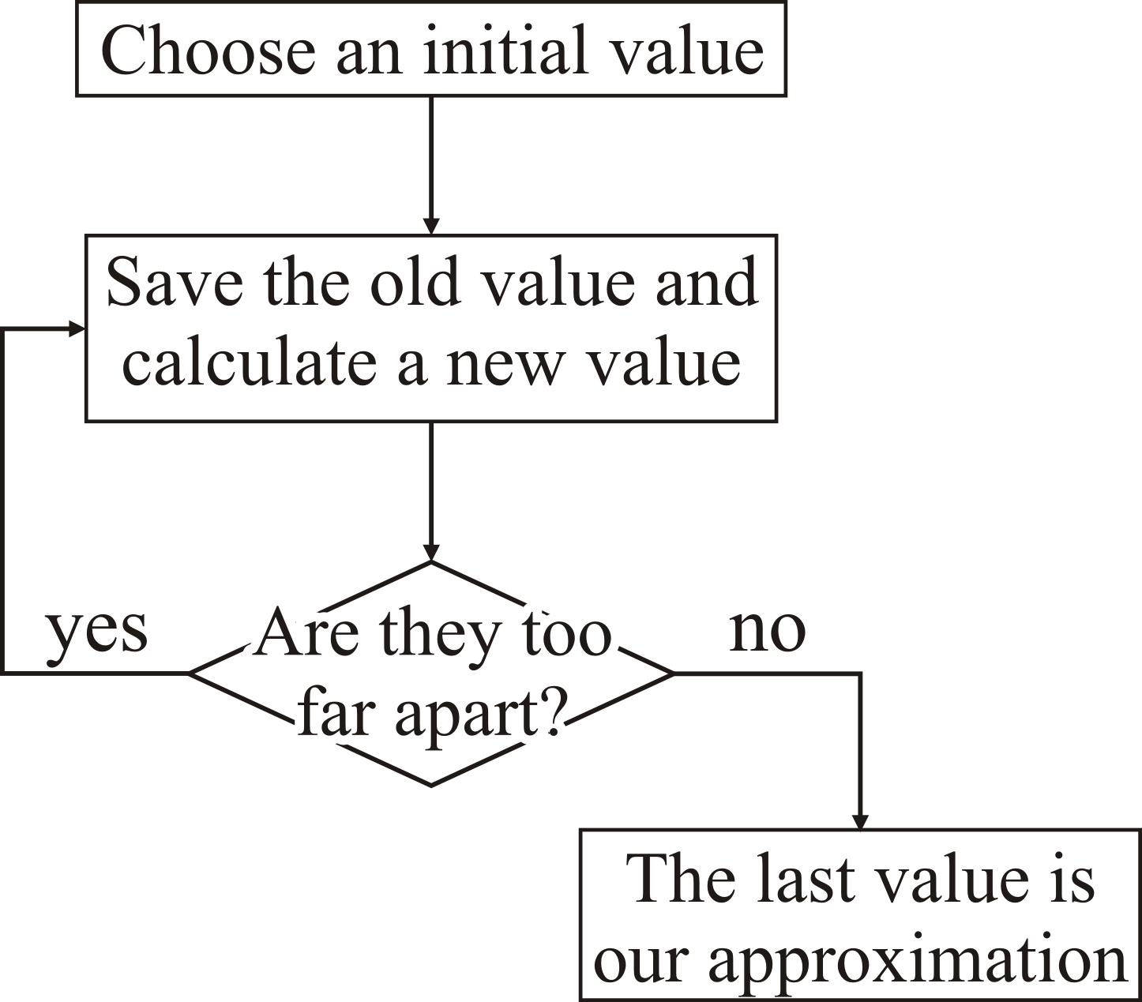
Fixed-point iteration
A simplified flow chart is as follows:

Slide 12
Fixed-point iteration
Normally, however, the condition is affected by the action of the looped block of statements
#include <cmath>
double cosine_fixed_point();
double cosine_fixed_point() {
double x_current{1.0};
double x_previous;
do {
x_previous = x_current;
x_current = std::cos( x_current );
} while ( std::abs( x_previous - x_current ) > 1e-10 );
return x_current;
}

Slide 13
Fixed-point iteration
Suppose you try finding the fixed point of cot(x)
There are infinitely many fixed points:
The code requires hardly any modification…
do {
x_previous = x_current;
x_current = 1.0/std::tan( x_current );
} while ( std::abs( x_previous - x_current ) > 1e-10 );

Slide 14
Fixed-point iteration
Problem: it runs forever
In this case, it is in a non-terminating loop
How can we deal with this?
In engineering, it is essential to ensure that no loop runs forever, even accidentally, as from the jpl coding standard:
Rule 3 (loop bounds)
All loops shall have a statically determinable upper-bound on the maximum number of loop iterations.
Here, static means that a reader can look at the code and determine the upper bound before the source code is compiled

Slide 15
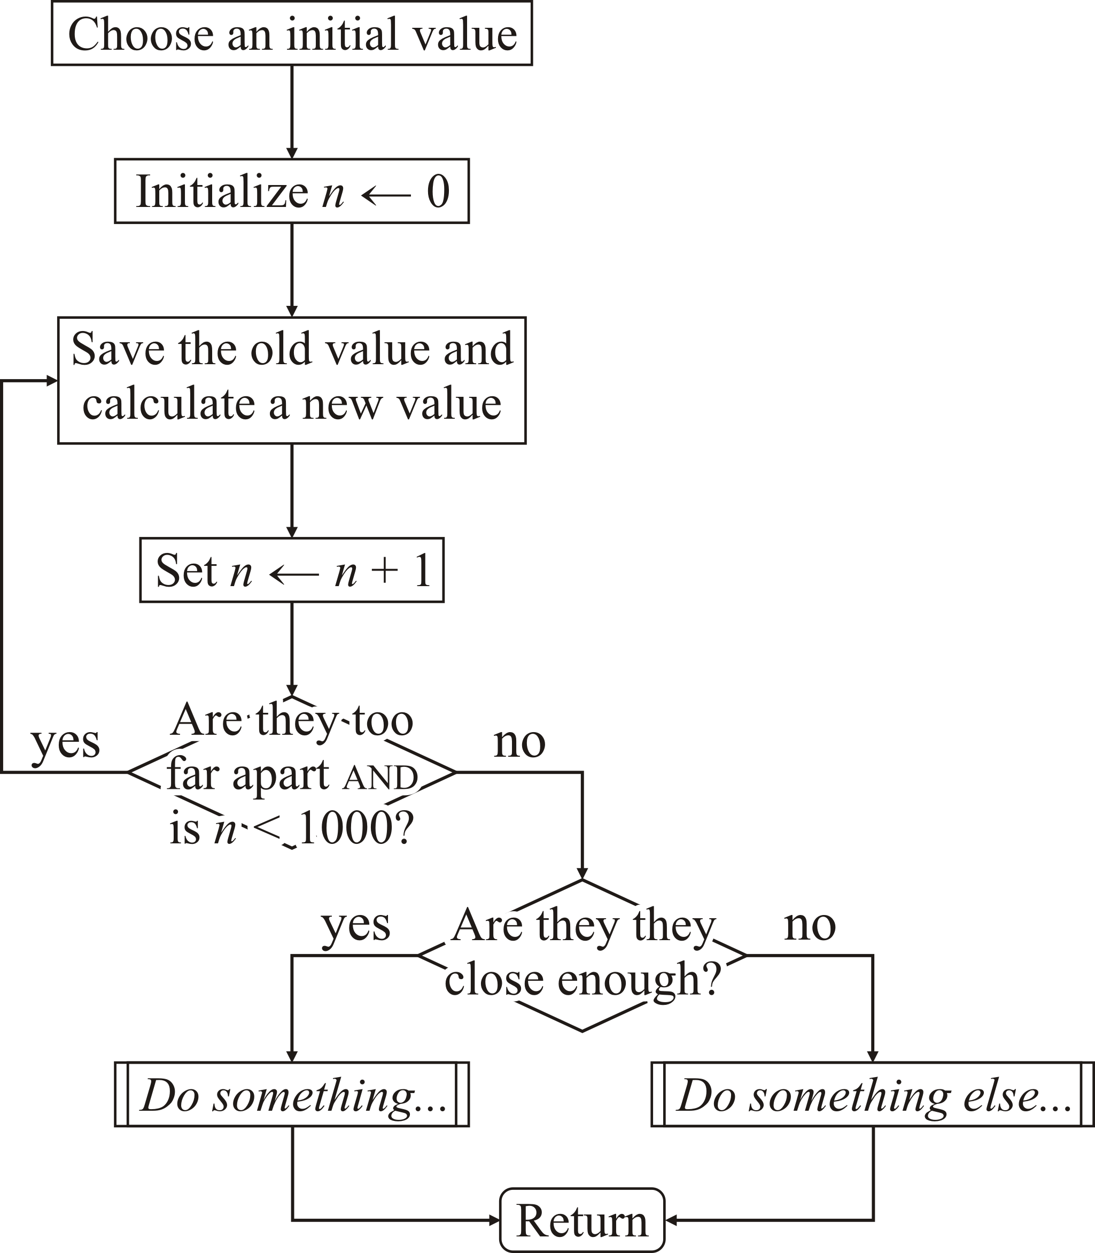
Fixed-point iteration
Here we stop if we exceed 1000 iterations:

Slide 16
Fixed-point iteration
Here is our implementation:
double fixed_point();
void fixed_point() {
double x_current{1.0};
double x_previous{};
unsigned int num_iterations{0};
do {
++num_iterations;
x_previous = x_current;
x_current = std::cos( x_current );
} while ( (std::abs( x_previous - x_current ) > 1e-10)
&& (num_iterations < 1000) );
if ( std::abs( x_previous - x_current ) <= 1e-10 ) {
std::cout << "Fixed point: " << x_current << std::endl;
} else {
std::cout << "Did not converge..." << std::endl;
}
}

Slide 17
Fixed-point iteration
Try this yourself:
#include <cmath>
#include <iostream>
// Function declarations
void fixed_point();
int main();
// Function definitions
int main() {
fixed_point();
return 0;
}
void fixed_point() {
double x_current{1.0};
double x_previous{};
unsigned int num_iterations{0};
do {
++num_iterations;
x_previous = x_current;
x_current = std::cos( x_current );
} while ( (std::abs( x_previous - x_current ) > 1e-10)
&& (num_iterations < 1000) );
if ( std::abs( x_previous - x_current ) <= 1e-10 ) {
std::cout << "Fixed point: " << x_current << std::endl;
} else {
std::cout << "Did not converge..." << std::endl;
}
}

Slide 18
Summary
Following this lesson, you now
Understand how to implement do-while loops in C++
Have seen how to repeatedly respond to data from the user or sensors
Have had exposure to numerical algorithms
Understand why it is necessary to limit the number of times the statement block is executed

Slide 19
References
[1] Wikipedia
https://en.wikipedia.org/wiki/Do_while_loop

Slide 20



Colophon
These slides were prepared using the Georgia typeface. Mathematical equations use Times New Roman, and source code is presented using Consolas.
The photographs of lilacs in bloom appearing on the title slide and accenting the top of each other slide were taken at the Royal Botanical Gardens on May 27, 2018 by Douglas Wilhelm Harder. Please see
https://www.rbg.ca/
for more information.

Slide 21
Disclaimer
These slides are provided for the ece 150 Fundamentals of Programming course taught at the University of Waterloo. The material in it reflects the authors’ best judgment in light of the information available to them at the time of preparation. Any reliance on these course slides by any party for any other purpose are the responsibility of such parties. The authors accept no responsibility for damages, if any, suffered by any party as a result of decisions made or actions based on these course slides for any other purpose than that for which it was intended.

